Slide 1
Lecture 2 What’s inside LLMs

Slide 2
What is a LANGUAGE?

Slide 3
LANGUAGE MODELING
Can we model language as a sequence of words that is being generated by an underlying “stochastic” process?

Slide 4
Questions that an LM can answer
Which of the following two sentences are more likely?
“How to recognize speech”
“How to rake a nice beach”
Which of these words is more likely to follow the following sequence: deep or neural or lovely?
The woods are lovely, dark and __________
Which of these sentences sound more fluent?
I have been studying in IISc for 6 months.
I am being studying in IISc for 6 months.

Slide 5
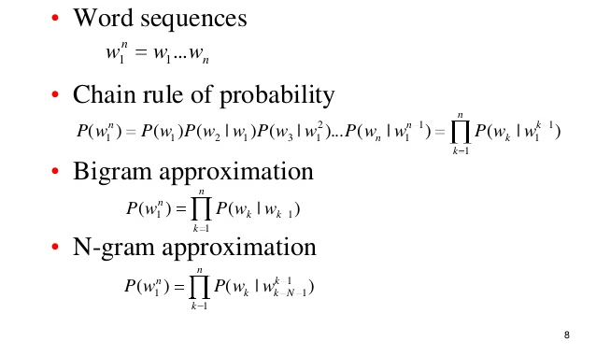
N-gram language models
The woods are lovely, dark and ________

Slide 6

Supervised Deep Learning
Sentence | Label
This is the best movie I have seen recently. | +1
Watch it only if you have nothing better to do. | -1
The acting was great, but plot wasn’t. | 0

Slide 7
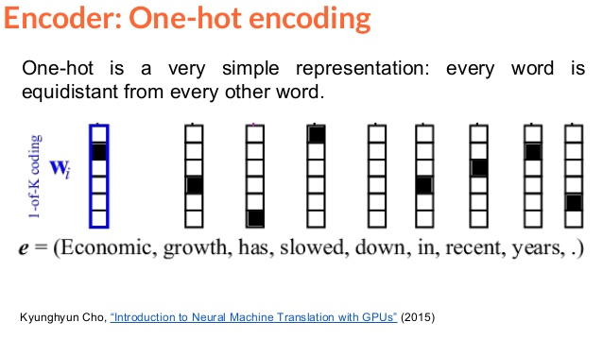
How to input words to neural networks?
Problems of One-hot encoding:
Very large input layer (100k+)
Doesn’t exploit semantic and syntactic relation between words

Slide 8
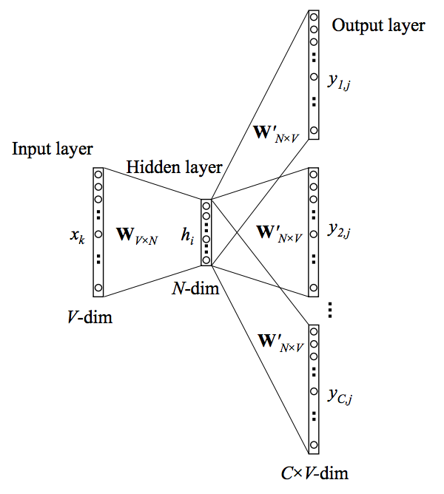
Word Embeddings
“You shall know a word by the company it keeps.”
- Firth, 1957
Predict words that occur around the input word
Input word (whose embedding is to be learnt) as one-hot encoding
Embedding of x_{k}
(Mikolov et al. 2013)

Slide 9
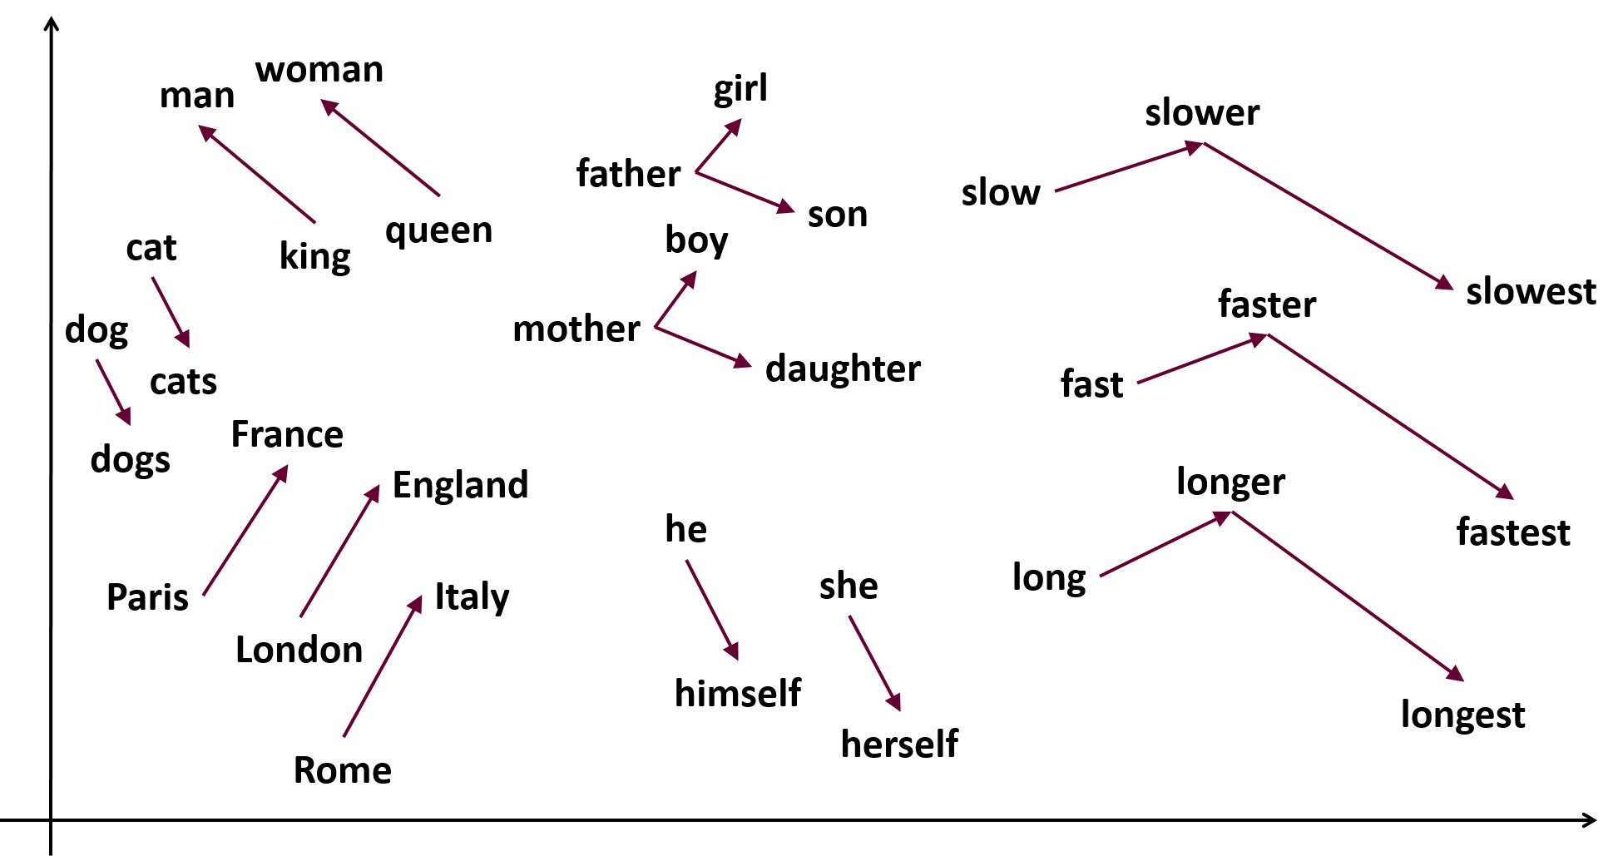
https://www.samyzaf.com/ML/nlp/nlp.html

Slide 10
Some Observations and Remarks
The network can be used to predict the word from context or vice-versa.
Only unlabeled text required to learn word-embeddings (unsupervised learning)
Word embeddings are nothing but language models
Word2vec, FastText
Pre-trained Word-embeddings:
Task agnostic, off-the-shelf, can be specifically tuned to or trained for domains, genre, and of course, languages.

Slide 11
Task-specific Fine-tuning
Sentence | Label
This is the best movie I have seen recently. | +1
Watch it only if you have nothing better to do. | -1
The acting was great, but plot wasn’t. | 0
TASK SPECIFIC LAYER(S)
Better performance with small amounts of labeled data

Slide 12
Two problems
Problem 1: What about out-of-vocabulary words?
Especially for agglutinative and morphologically rich languages?
Related problem: how to learn good representations for rare words?
Problem 2: What about context?
Word forms do not tell us everything.
Same form (“bank”, “set”, …) and therefore same representation, but different meaning

Slide 13
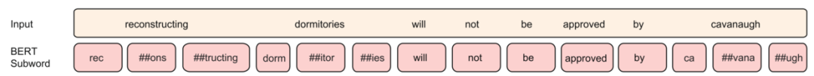
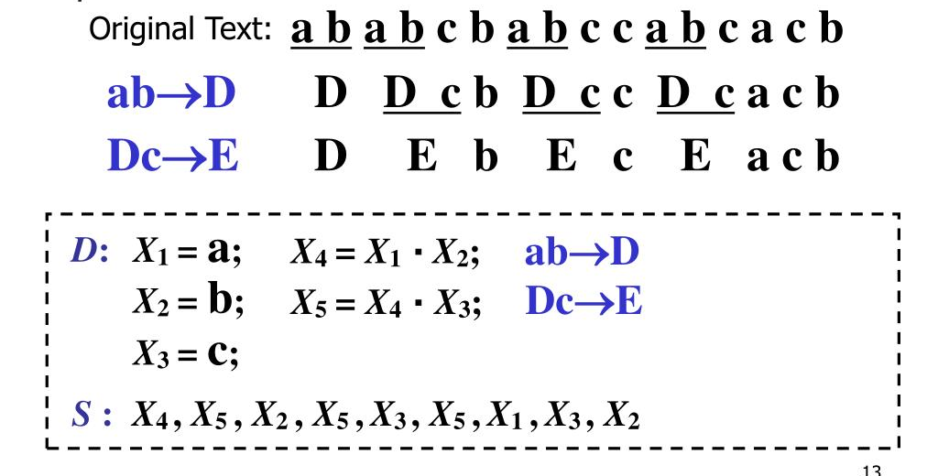
Solution 1: Sub-words and Byte-Pair Encoding
Represent each character as a subword.
Count the frequency of the subword pairs.
The one with the highest frequency is represented as a new sub-word.
Loop through steps #2 and #3 till the number of unique sub-word reaches a maximum limit.

Slide 14
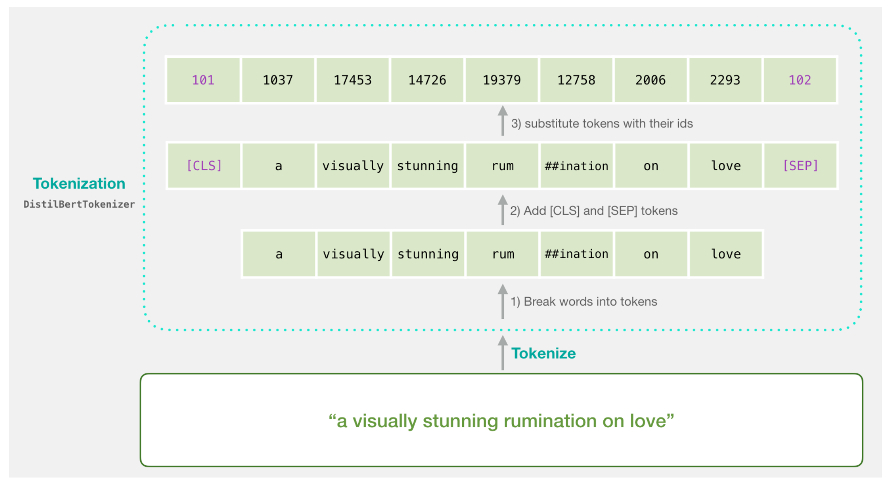
A Visual Guide to Using BERT for the First Time – Jay Alammar – Visualizing machine learning one concept at a time. (jalammar.github.io)

Slide 15
How to represent sentences?
Bag of word models
Average of embeddings of all words in a sentence
Weighted average
A dog bites a man.
Em(a) + Em(dog) + Em(bites) + Em (a) + Em(man)
How to represent sequences?

Slide 16
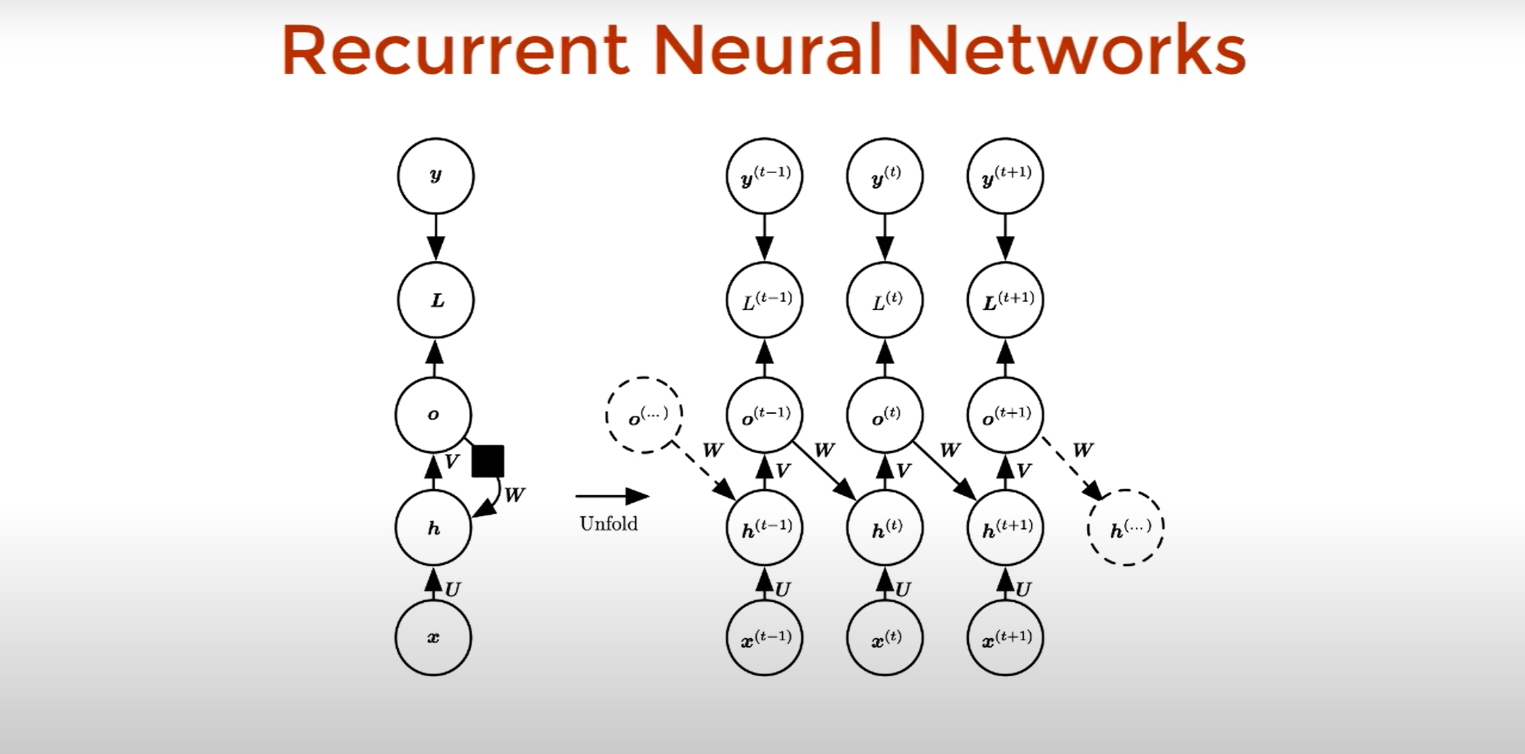

Slide 17
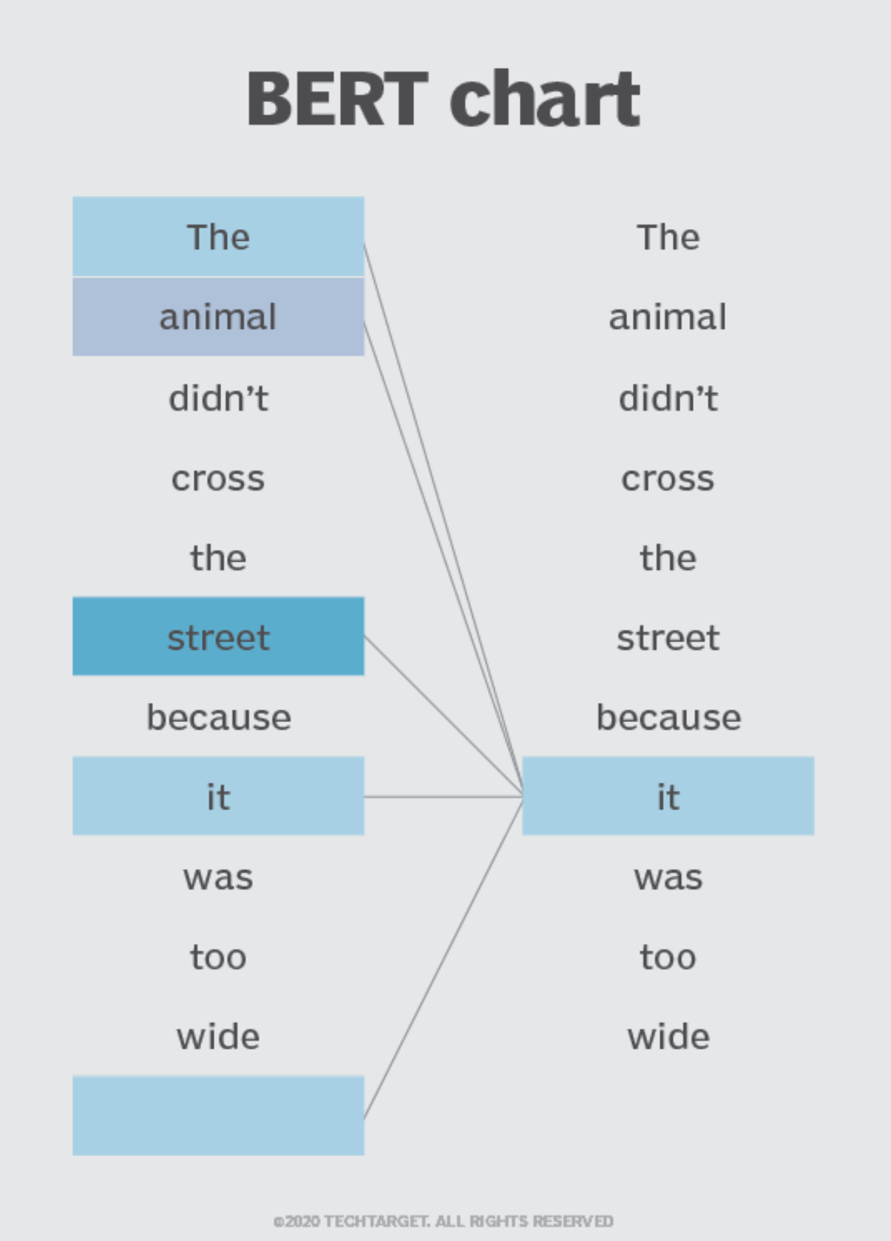
Capturing long range dependencies

Slide 18
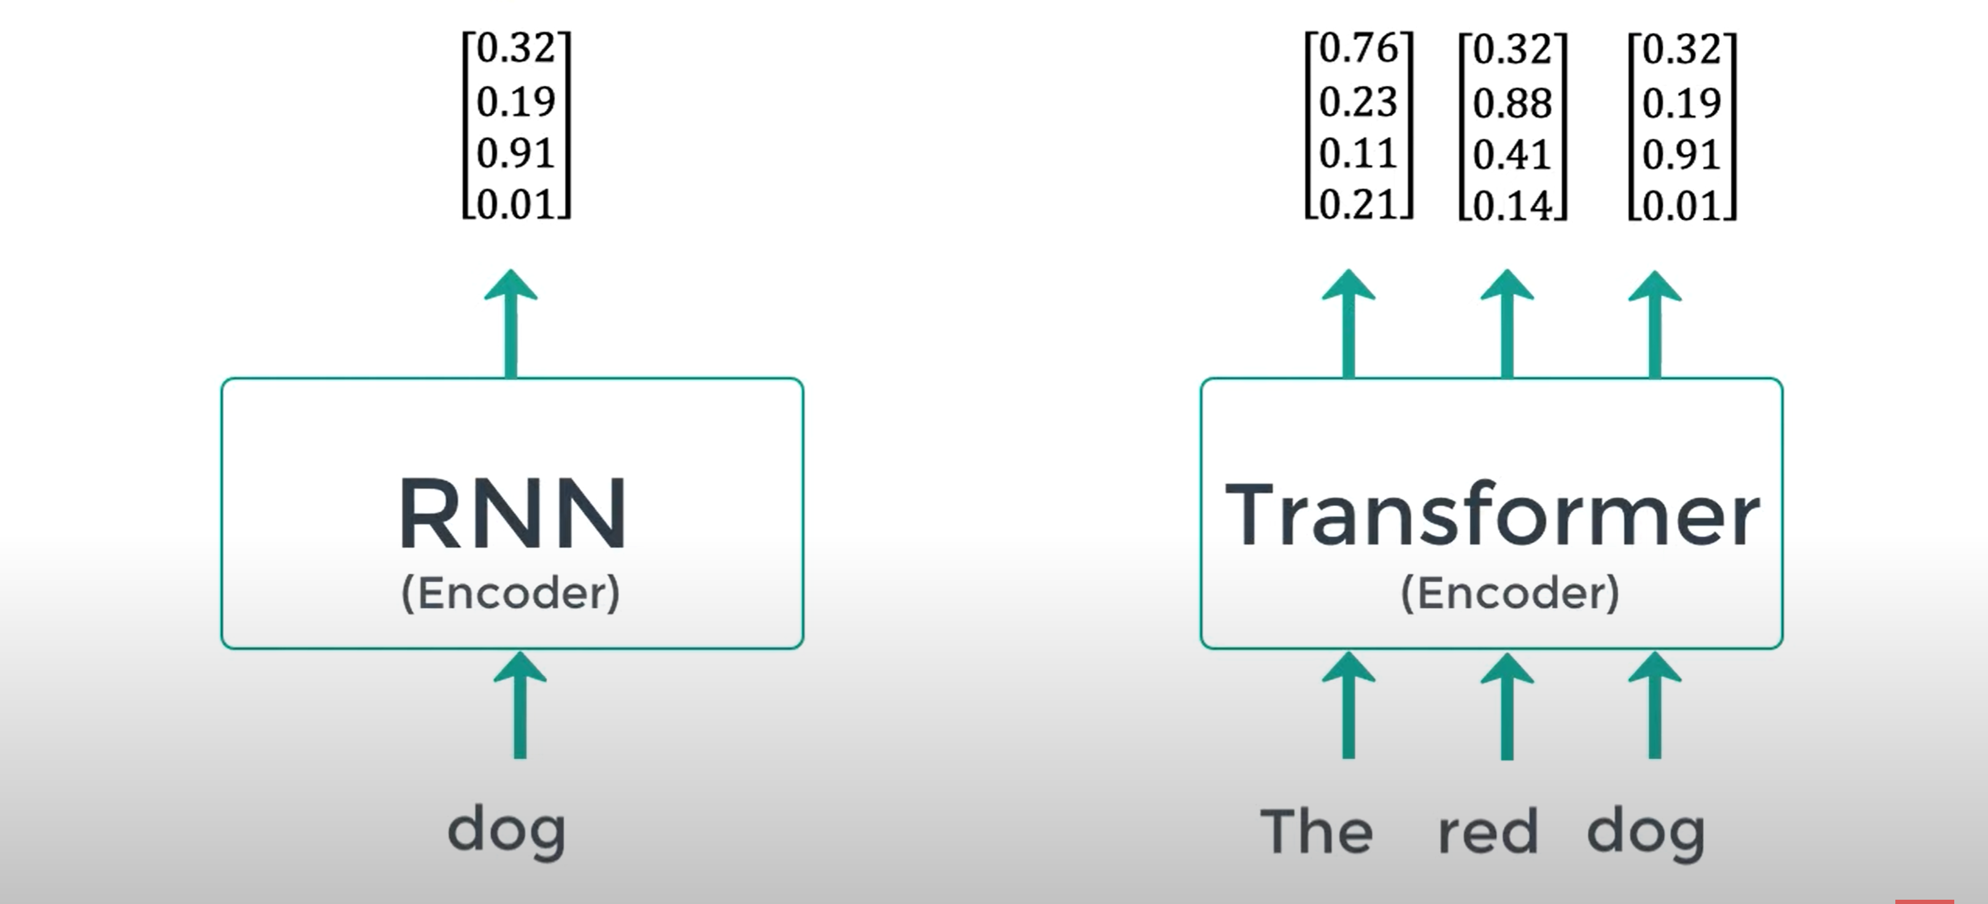

Slide 19
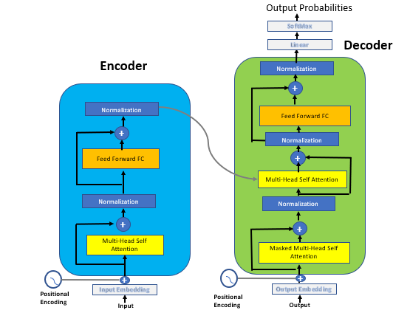
Transformer architecture (Vaswani et al., 2017)

Slide 20
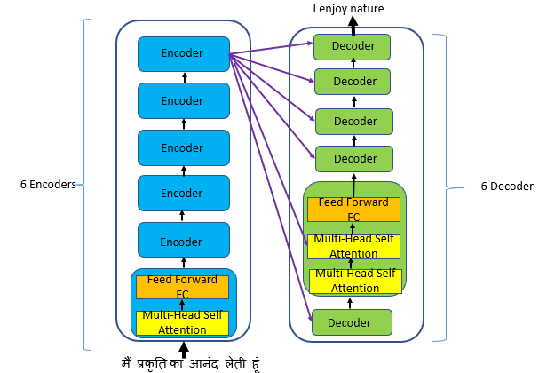
Transformer architectures
Source: Simple Explanation of Transformers in NLP | by Renu Khandelwal | Towards Data Science

Slide 22
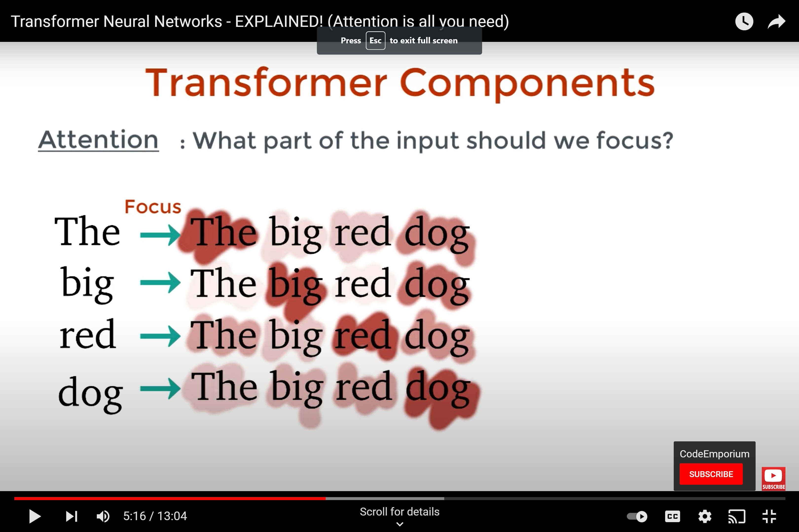
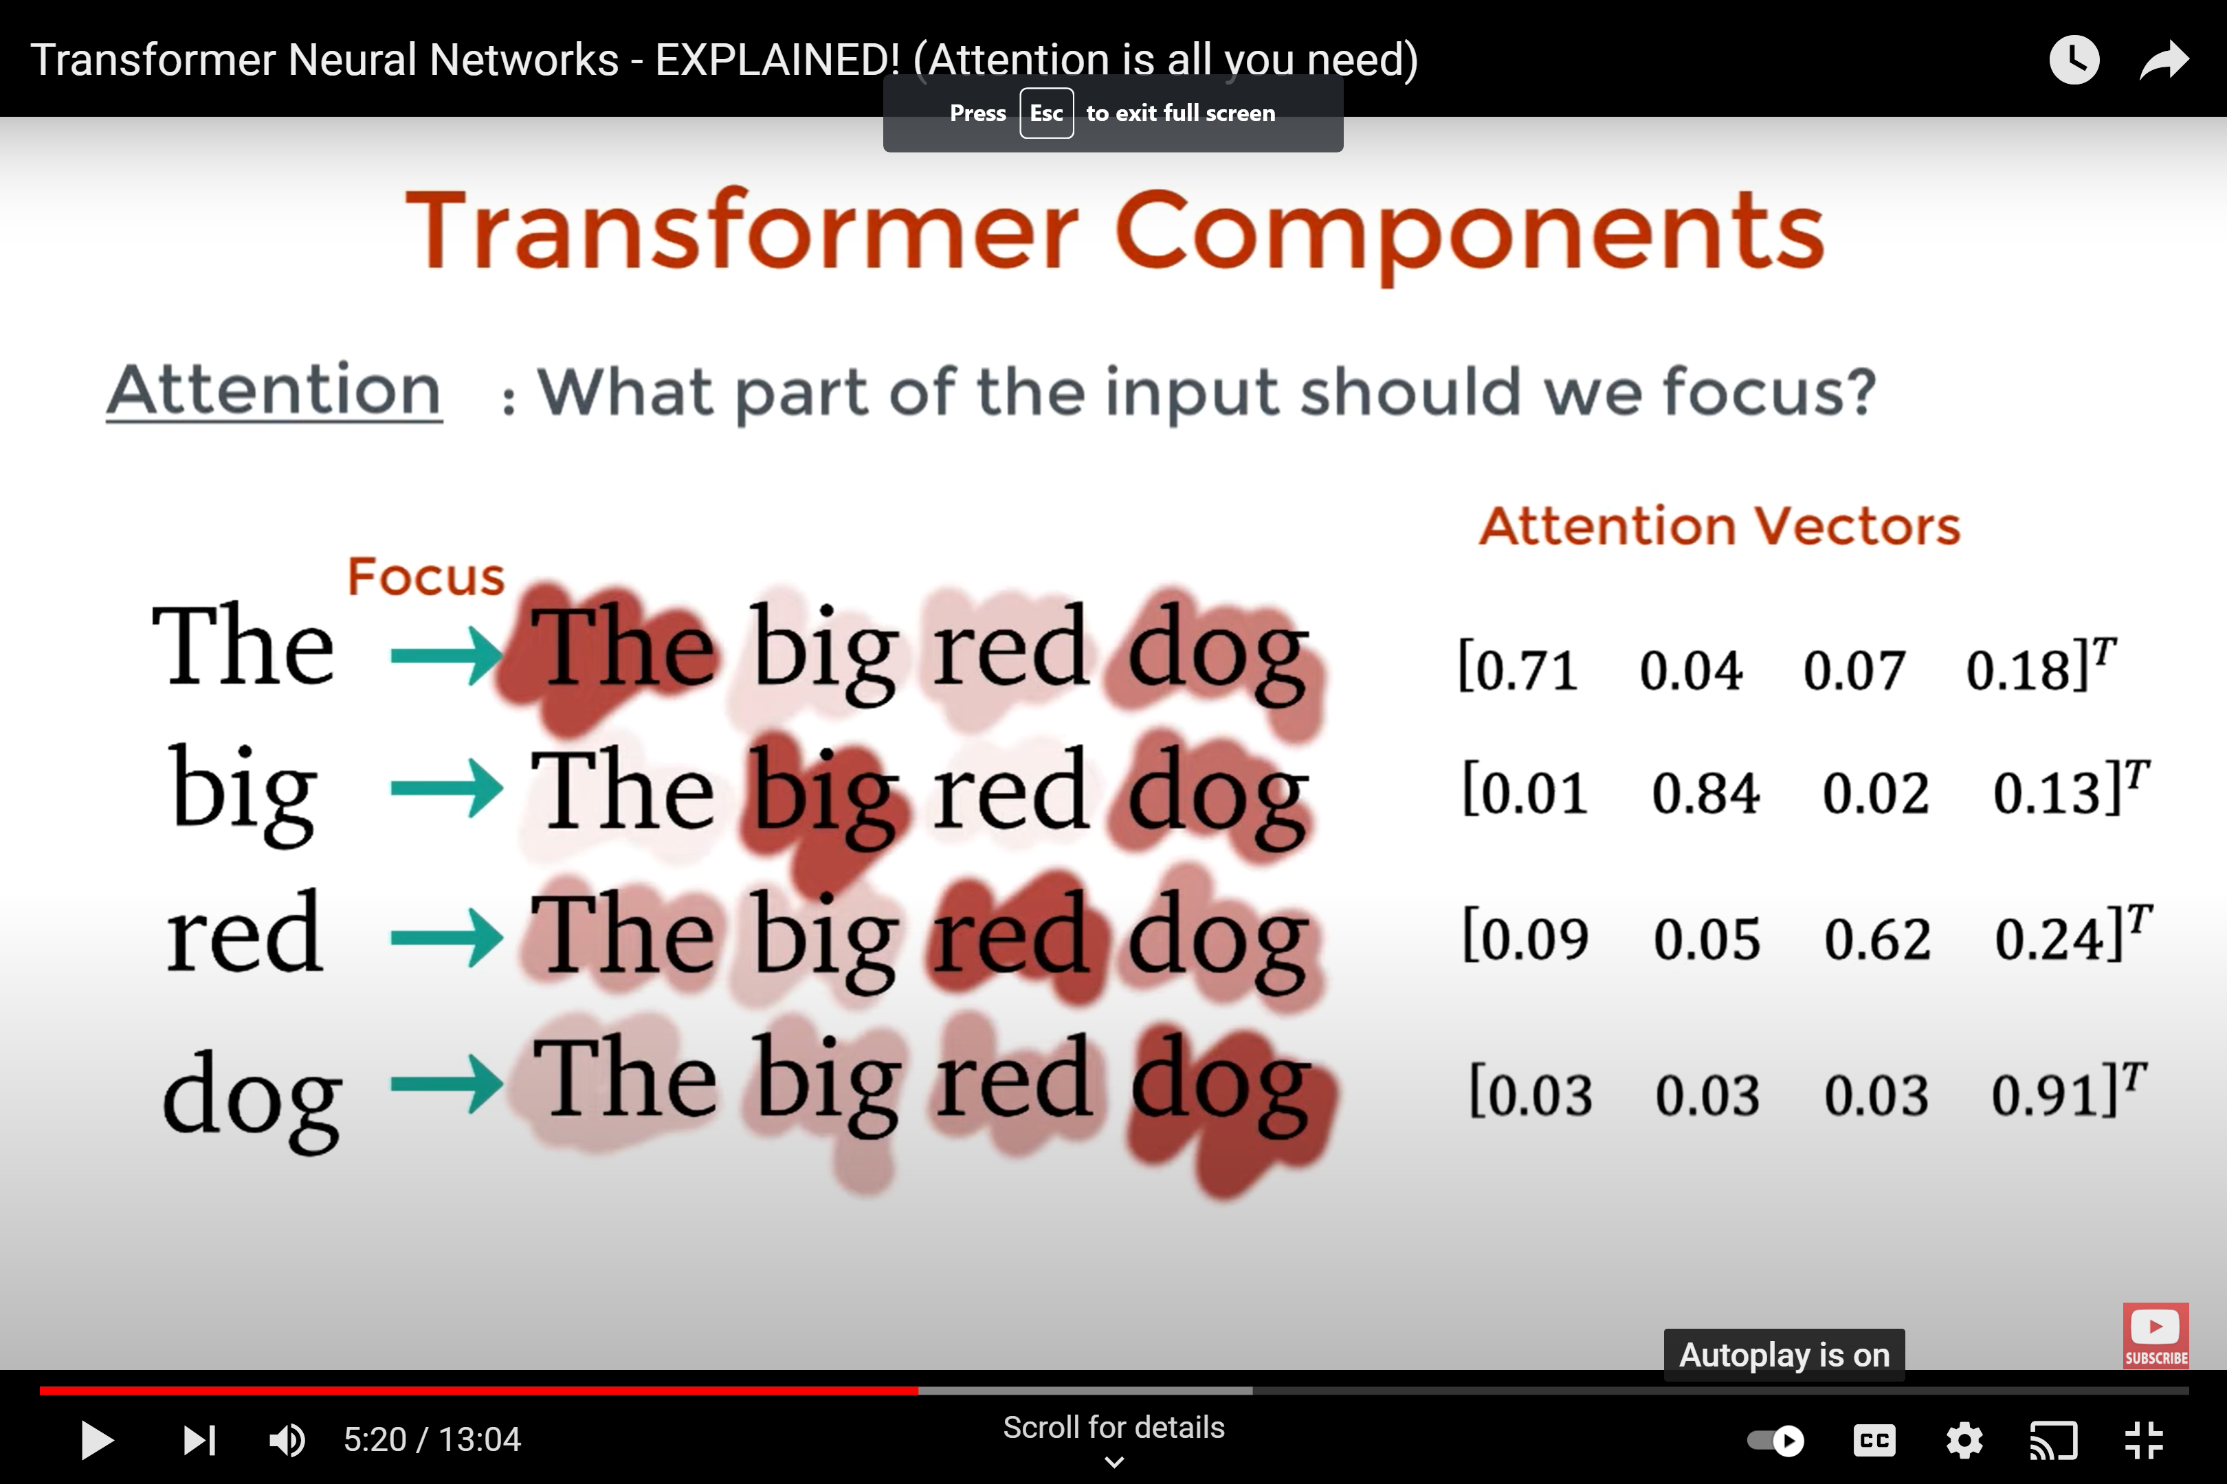

Slide 23
The Illustrated Transformer – Jay Alammar – Visualizing machine learning one concept at a time. (jalammar.github.io)

Slide 24
Encoder only models
BERT, mBERT
RoBERTa, XLMR
Decoder only models
GPT family
Encoder-Decoder Models
T5, MT5
LLAMA family

Slide 25
How to Evaluate LMs?
Intrinsic Evaluation: A measure of how good the model is with respect to its defined functionality.
Extrinsic Evaluation: Use the model to solve a (extrinsic) task. The better the accuracy on the end task, the better the model.

Slide 26
Intrinsic Evaluation of LMs
The woods are lovely, dark and __________
Words | Probability according to Model 1 (x10⁻⁵) | Probability according to Model 2 (x10⁻⁵)
deep | 12 | 21
green | 50 | 18
neural | 0.01 | 10
volatile | 0.1 | 7
wild | 4 | 16
old | 17 | 12

Slide 27
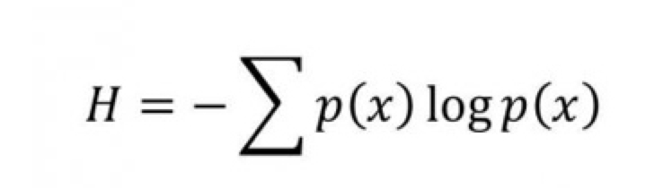
Information Entropy
Information entropy of a distribution measures the randomness.
A language model with high predictability should have low entropy.
Perplexity = 2^{H}

Slide 28
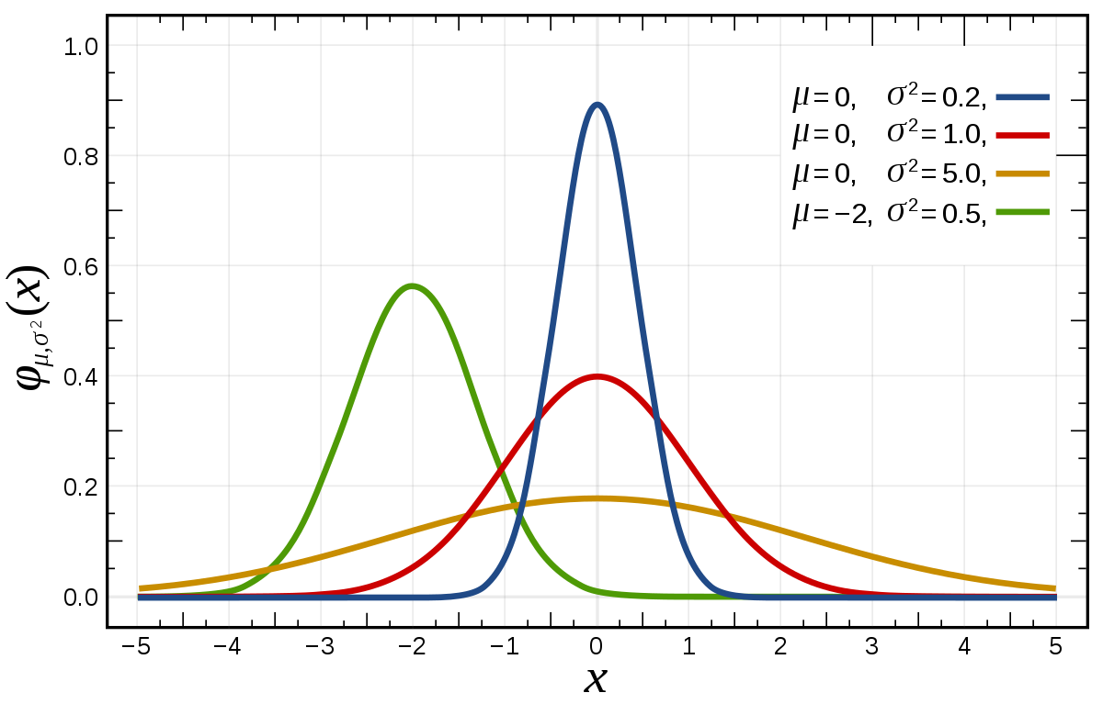
Which of the following distributions have lowest entropy?

Slide 29
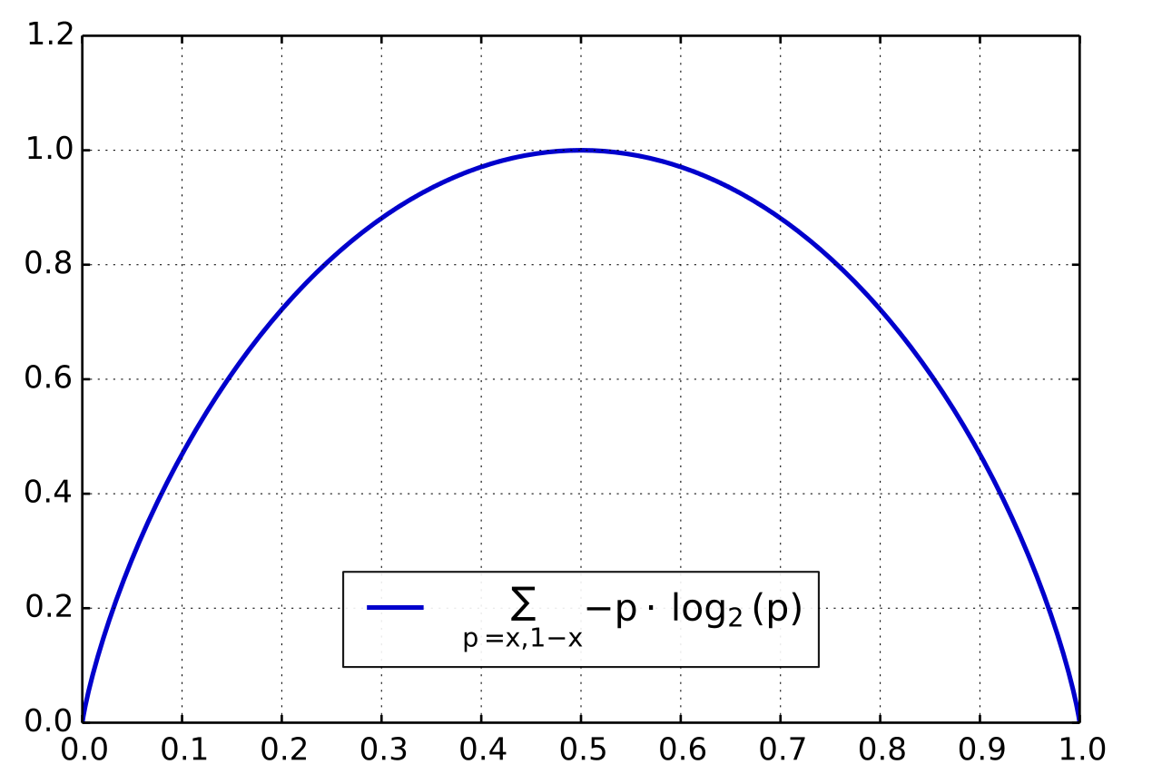
Entropy of a coin toss

Slide 30
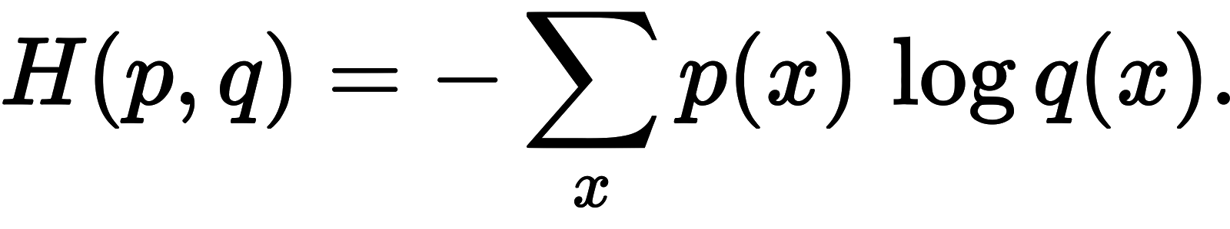
Cross Entropy
Distribution predicted
by the LM
Distribution computed on held out test data

Slide 31
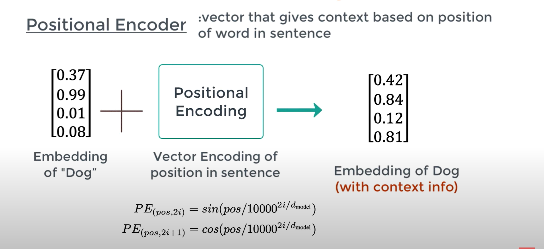

Slide 32
Self-attention

Slide 33
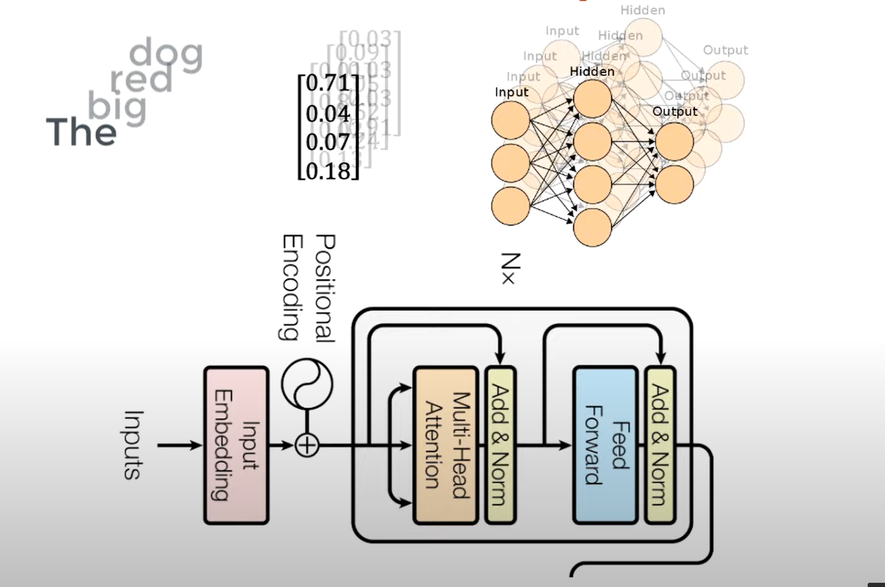

Slide 34
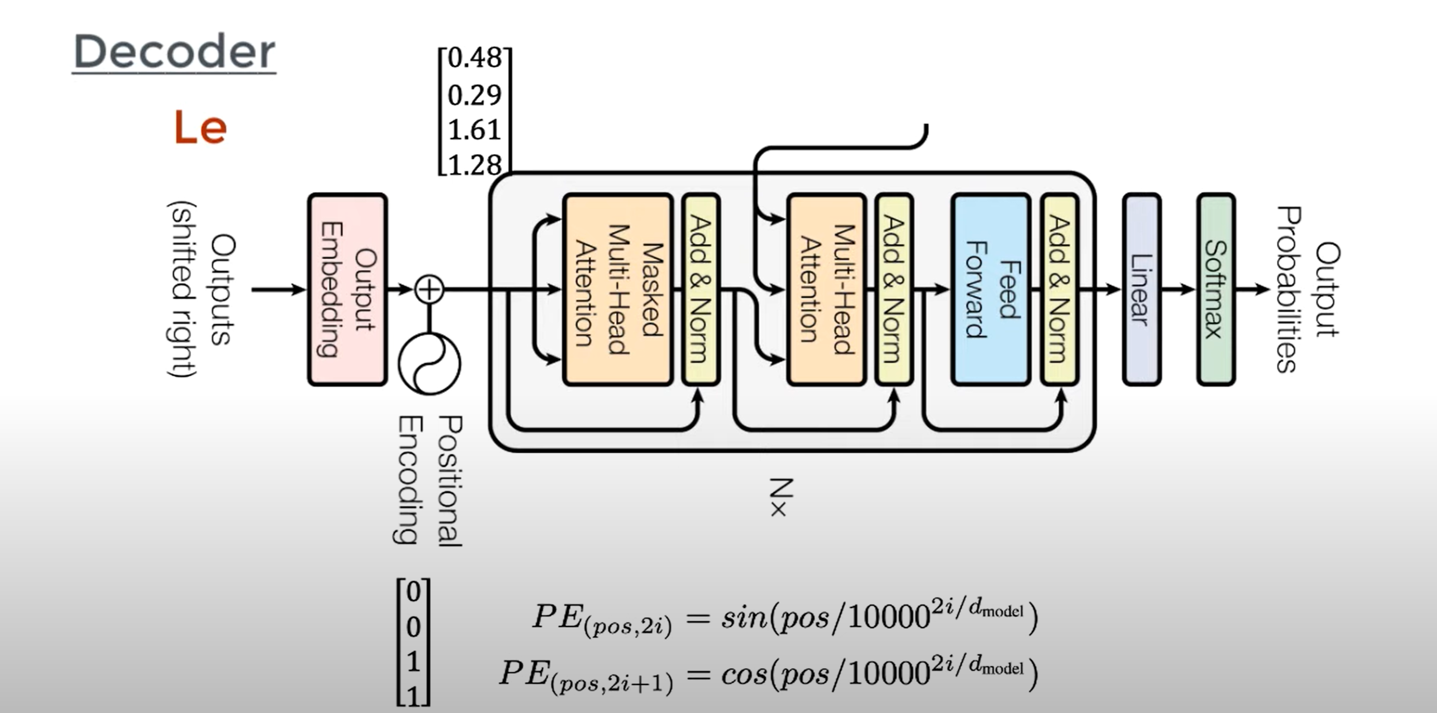

Slide 35
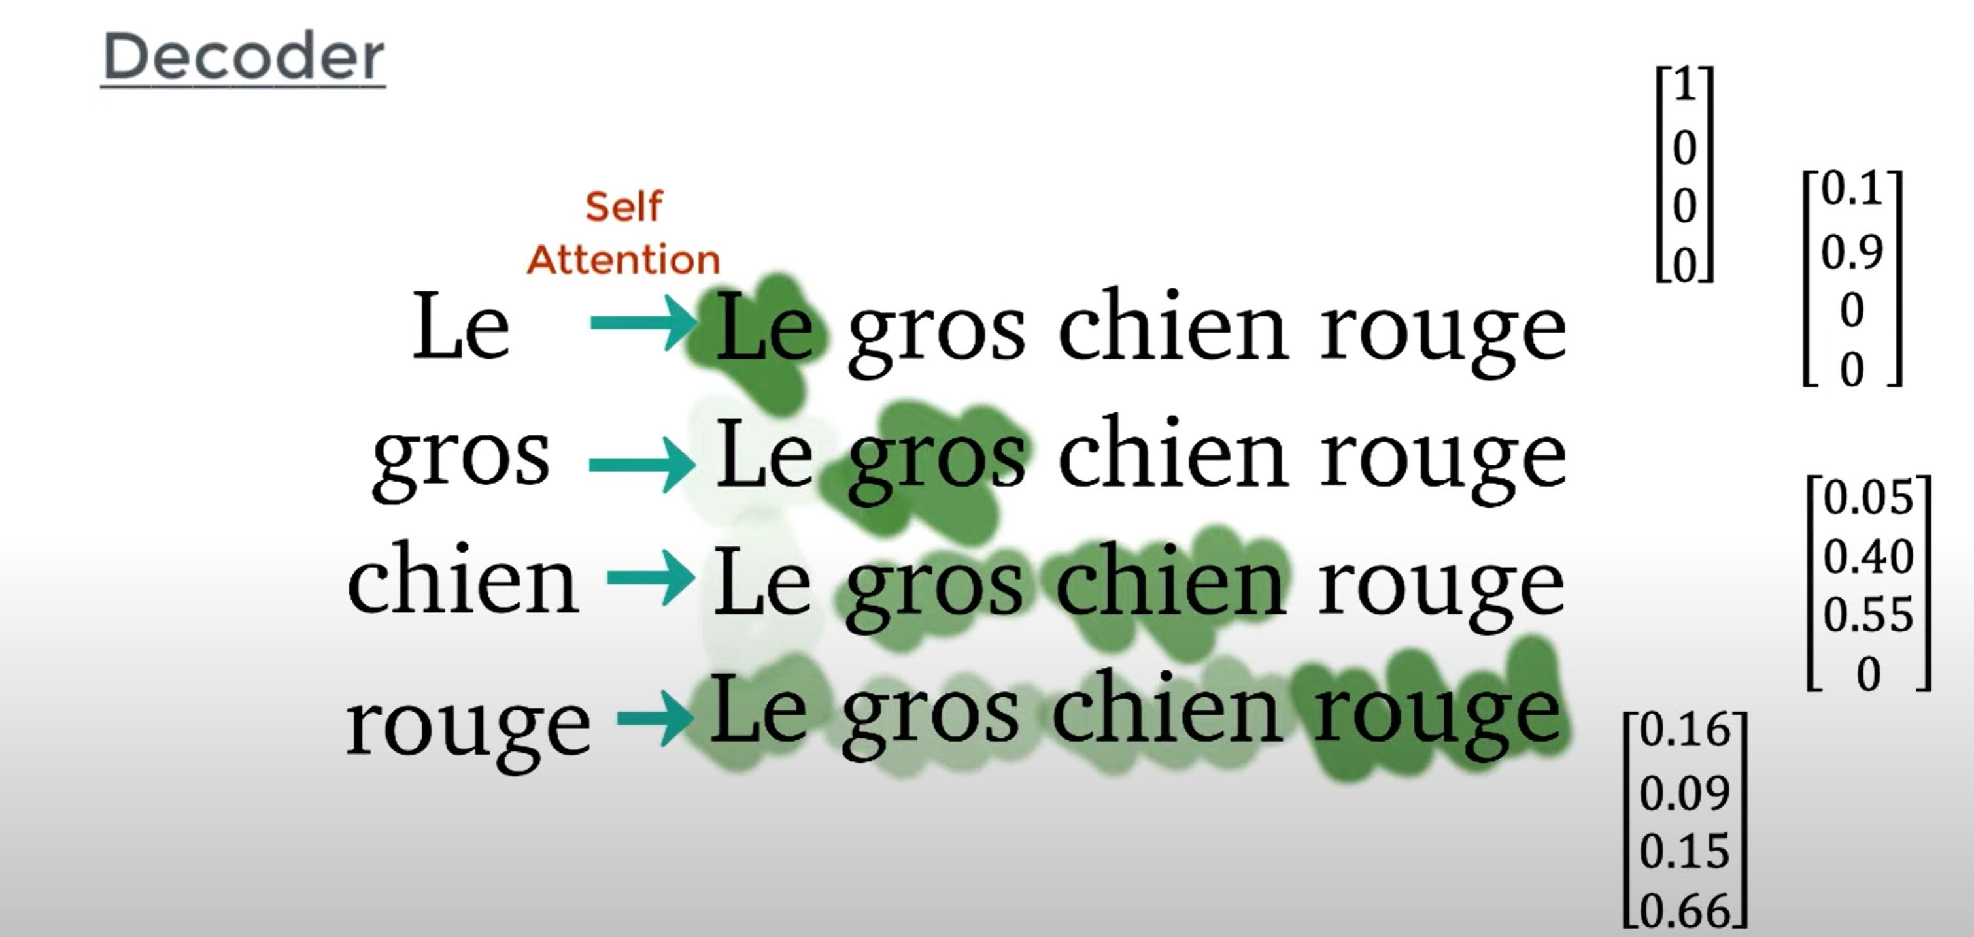

Slide 36
